Slide 1
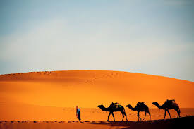
METABOLIC SWITCH FOR DESERT SURVIVAL.
GROUP 10

Slide 2
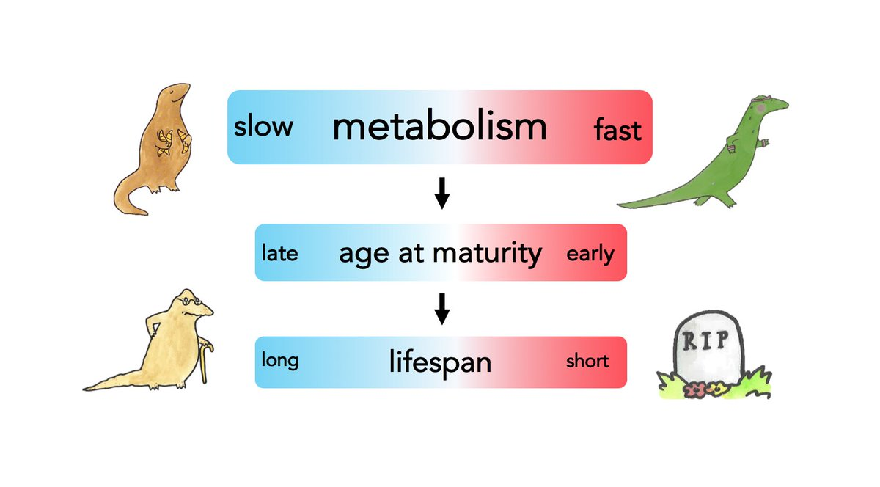
INTRODUCTION.
Deserts are regions where water and food are in short supply, posing challenging physiological problems for animal survival.
Drought is a major cause of food scarcity on the desert.
Desert animals have become more adapted for food scarcity than their non-desert relatives.
Fig 1; Metabolic Switching

Slide 3
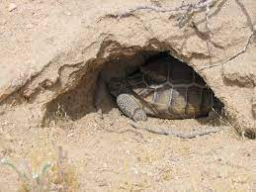
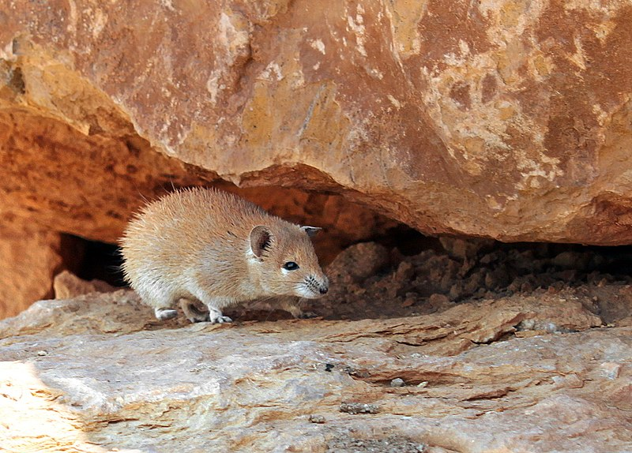
TYPES OF METABOLIC SWITCH FOR DESERT SURVIVAL.
Fig 2; Aestivation
Fig 3; Torpor
Fig 4; Low resting metabolic rate

Slide 4
LOW RESTING METABOLIC RATE.
Resting metabolic rate refers to the amount of calories burned when the body in completely at rest.
Desert animals have developed adaptations to lower the rate of resting metabolic reaction during food scarcity in other to survive longer.
It is one common physiological adaptation for desert life.
Resting metabolic rates 10-30% below values predicted by Kleiber’s allometric equation have been observed in desert mammals ranging from insectivores and marsupials to rodents, carnivores, and ungulates.

Slide 5
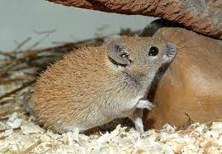
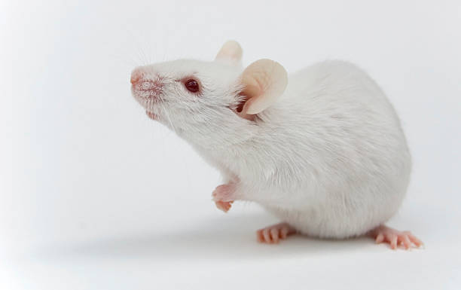
CASE STUDY BY JUAN MERKT AND RICHARD TAYLOR.
Fig 5; The Golden Spiny Mouse
Fig 6; White Mouse

Slide 6
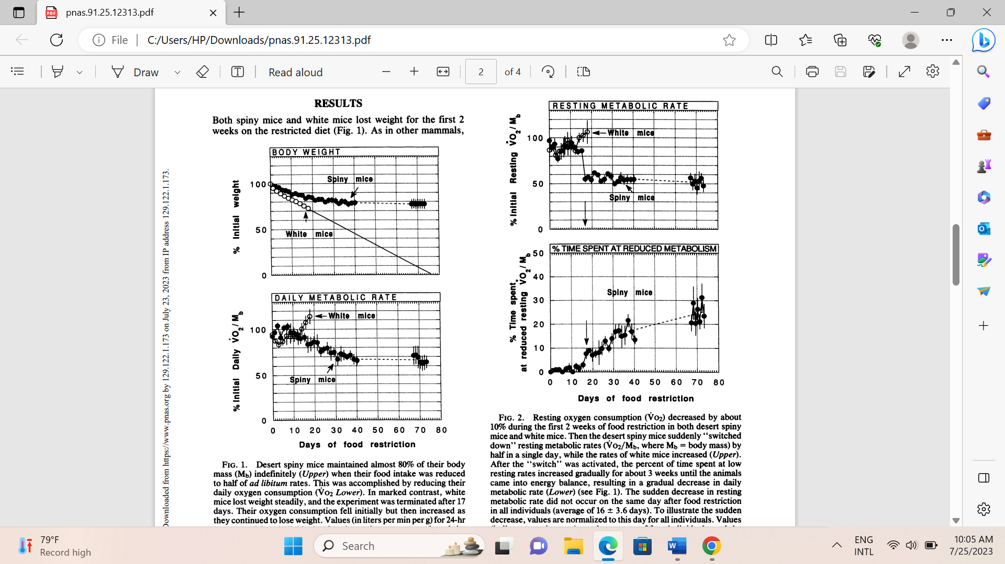
CASE STUDY BY JUAN MERKT AND RICHARD TAYLOR.

Slide 7
HOW DO DESERT ANIMALS SWITCH THEIR METABOLISM DOWN.
Reduction in oxygen consumption.
Reduction in rate of energy consumption processes.
Reduction in thyroxin secretion.

Slide 8
ADVANTAGE OF LOW RESTING METABOLIC RATE.
It helps conserve energy to prolong life span while maintaining some level of body activity as compared to the torpor which reduces the animal’s activity.

Slide 9
CONCLUSION.
This adaptation of desert mammals to desert life may provide a powerful tool for investigating metabolic response to food scarcity and starvation common to all mammals, including humans.

Slide 10
REFRENCES.
JUAN R. MERKT and C. RICHARD TAYLOR (1994). “Metabolic Switch” for desert survival.
Wilz M, Heldmaier G. Comparison of hibernation, estivation and daily torpor in the edible dormouse, Glis glis. J Comp Physiol B. 2000 Nov;170(7):511-21.

Slide 11
THANK YOU
.

